Slide 1
Project Update – Week 9
Tora Gao, Zheng Shi, Leon Zhang

Slide 2
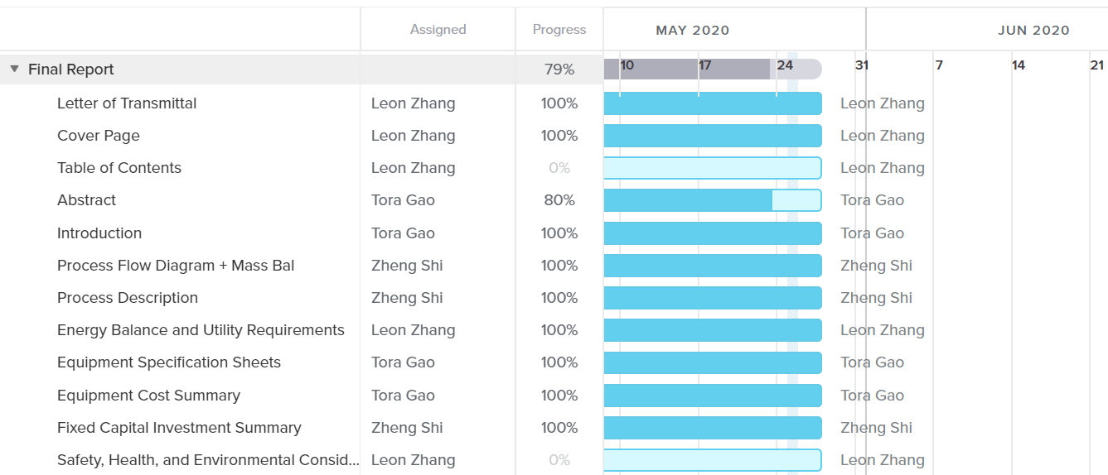
Gantt Chart
Notes:
https://prod.teamgantt.com/gantt/schedule/?ids=2115888#&ids=2115888&user=&custom=&company=&hide_completed=false&date_filter=&color_filter=

Slide 3
Tasks Completed
Most of final report done

Slide 4
Unexpected hurdles and Potential Solutions
Unexpected Hurdles:
N/A
Potential Solutions:
N/A

Slide 5
Short-Term and Long-Term Plans
Short-Term
Finish final report
Abstract
Table of contents
EH&S
Appendix
Start working on presentation
Long-Term
N/A

